Slide 1

Basics of Neural Networks
Steven Arroyo

Slide 2

Little bit about me!
Interned over the Summer at Comcast as a Cloud AI Solutions Architect
During that time, I created a virtual assistant & got a certification in ML on GCP!
Senior at Rowan

Slide 3
What is a Neural Net?
One of the more popular ways to achieve Machine Learning (Yes, there are more!)
Used to find patterns in data that were previously undiscovered.
Created to model how the human brain learns to essentially emulate it

Slide 4
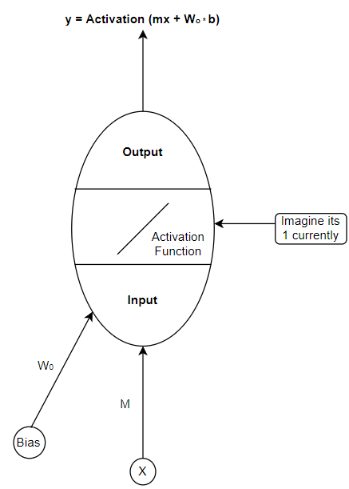
Neural Net is Composed of Neurons
Neuron has 3 main parts Input: Weights added to the neuron
Activation: Function that does SOMETHING to the input
Output: Often defined as Y
Note: This is a perceptron, so implementation is slightly different than what is used today.

Slide 5
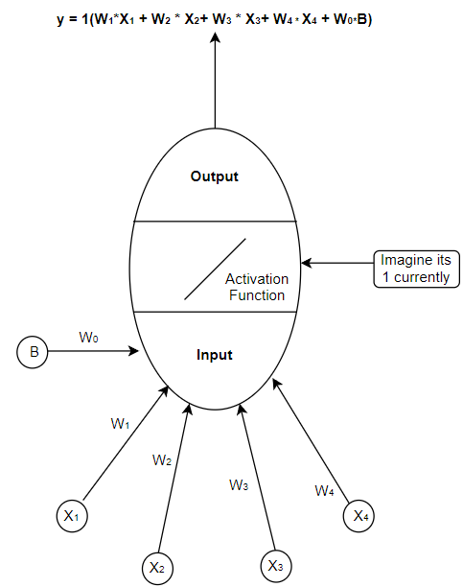

Neural Net is Composed of Neurons (Cont’d.)
Here, more weights are added to the neuron to show a more real example
Note about Activations: The one shown here is known as a linear activation function. Essentially if the activation is 2x it would multiply the inside by 2.

Slide 6
More information about activation functions
Activation functions on a continuous or linear model on a large-scale neural network is redundant and practically pointless.
This is primarily because if you have a bunch of linear equations, you can simplify it all to one neuron like in the last example, just with more weight.
You create more neurons in a network by using a discrete (non-continuous) model.
**All layers are discrete activation functions except the last one usually!

Slide 7
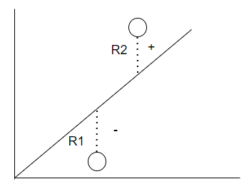
Light Overview of Learning
Residual: the vertical distance between as the actual vs predicted (line) value
Done via the y value because the x value is the input, and the y is the output so its essentially comparing outputs
How do you calculate the residual so there evenly distributed?

Slide 8
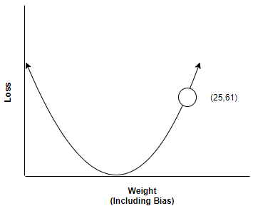
Light Overview of Learning Cont’d
Weight (W₁) | Expected (X) | Actual (X) | Residual
 | -2 | 5 | 9
 | -4 | 0 | 16
 | 5 | -1 | 36
25 |  | Total | 61
Residual = (Expected - Actual)²
The Sum of the residuals is put on a parabola of residuals
Why is this important? The bottom of the graph represents a low / minimal error rate in our graph

Slide 9
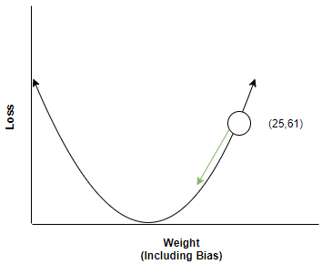
Quick Overview of Gradient Descent
You can find the derivative (or slope) of that value of the residual, after you find this derivative, you can tell what direction you need to go and adjust your weights accordingly.
Gradient of aw^2 + bw + c= 2w + b

Slide 10
Equations for Gradient Descent on higher weight problems (for those interested)
The idea behind the equation is essentially to find the partial derivative of each weight and multiply them (Chain Rule) to get your Gradient For Example: f’(y) = x + z
Gradient = f’(x) * f’(z)
Example on 2Weights: f’ (W₁, W₂)
7/8 W₁² + 4/6 W₂²
14/8 W₁ + 0
0 + 8/6W₂
f’ = 14/8W₁ * 8/6W₂
Note: You will have the weights so this is just for figuring out the gradient to use your loss

Slide 11
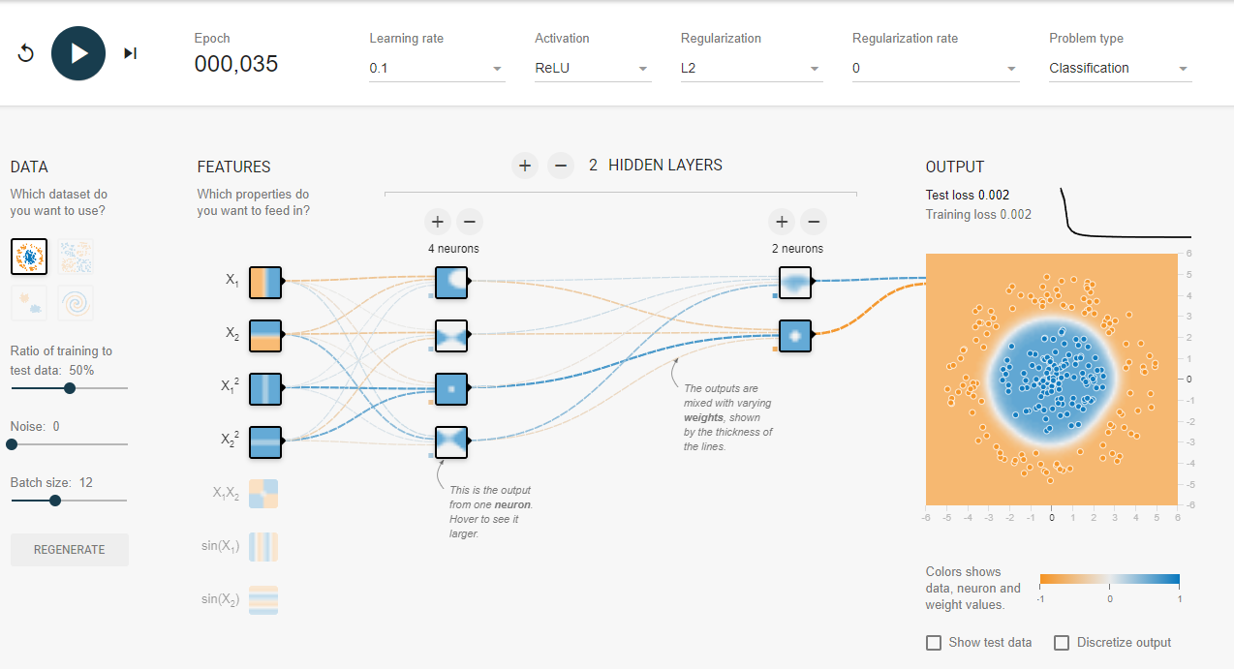
Neural Nets apply this over many neurons!
The idea behind neural nets are to learn one little part of the picture at a time
You feed a neural net inputs and hidden layer essentially tries to find parts of the bigger picture and the output are all the pieces put together

Slide 12
Finishing Notes Before the Demo
Deep Learning is simply just neurons with many hidden layers
Activation functions are very useful in ensuring speed and efficiency throughout a neural network
These are the foundations for all neural nets (The one we did is called ANN)
Link for TensorFlow Playground
https://playground.tensorflow.org/

